Slide 1
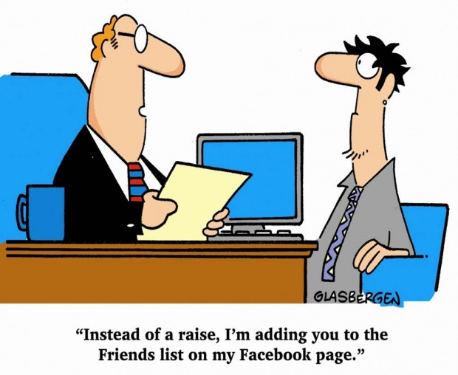

Slide 2
Electron Desktop Development for Web Developers
Codemash 2017

Slide 3
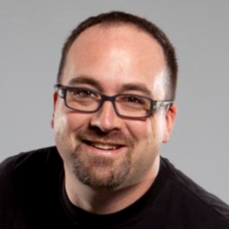
WELCOME
Chris Woodruff
cwoodruff@live.com
@cwoodruff
GitHub -- cwoodruff

Slide 4
OUR AGENDA



WHAT IS ELECTRON?
DEMOS!!!
PACKAGE IT UP

Slide 5


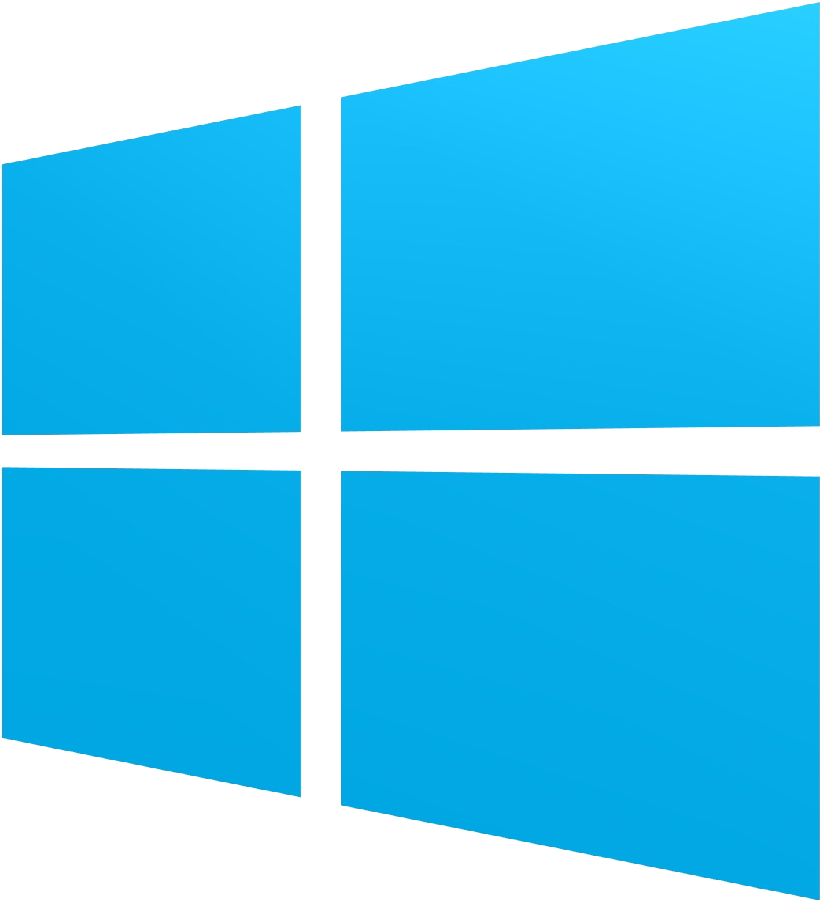



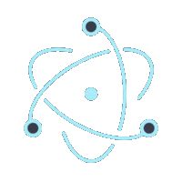




WHAT IF?

Work natively with platforms
✶
Leverage the current cross platform browser technologies and debugging tools

✶
Work offline and with slow network connections
Use modern web development libraries, frameworks and components

Slide 6
ABOUT ELECTRON

BUILT BY GITHUB

USES CHROMIUM AND NODE.JS

CROSS PLATFORM

NATIVE MENUS

INSTALLERS

OPEN SOURCED

Slide 7

DEMOS!!!!

Slide 8
SHELL PROCESS
Electron



RENDERER PROCESSES
BrowserWindow
BrowserWindow
BrowserWindow

Slide 9

ALL DEMOS ON GITHUB

Slide 10
FIND MORE AT
http://electron.atom.io/

Slide 11

QUESTIONS?

Slide 12
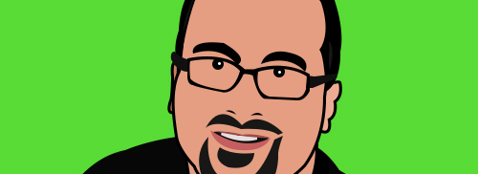
CONTACT ME
Chris Woodruff cwoodruff@live.com
616.72.6885
Twitter -- @cwoodruff
GitHub -- cwoodruff

Slide 13
THANK YOU FOR YOUR ATTENTION
Codemash 2017

